Slide 1
Matlab 教學4-像素處理
多媒體實習 助教：王泓權

Slide 2
4.1 Introduction
Any image-processing operation transforms the gray values of the pixels.
Image-processing operations may be divided into three classes based on the information required to perform the transformation.
Ch4-p.65

Slide 3
4.1 Introduction
From the most complex to the simplest, they are as follows:
Transforms
Neighborhood processing
Point operations
Ch4-p.65-66

Slide 4
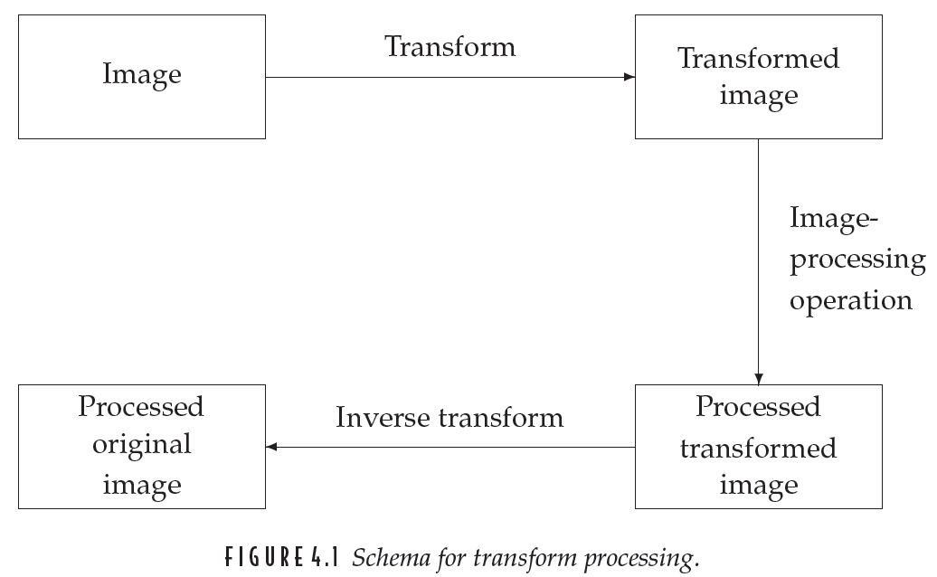
FIGURE 4.1
(Point operations)
Ch4-p.65

Slide 5
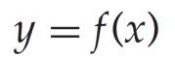
4.2 Arithmetic Operations
These operations act by applying a simple function
In each case we may have to adjust the output slightly in order to ensure that the results are integers in the 0 . . . 255 range (type uint8)
Ch4-p.66

Slide 6
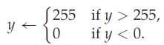
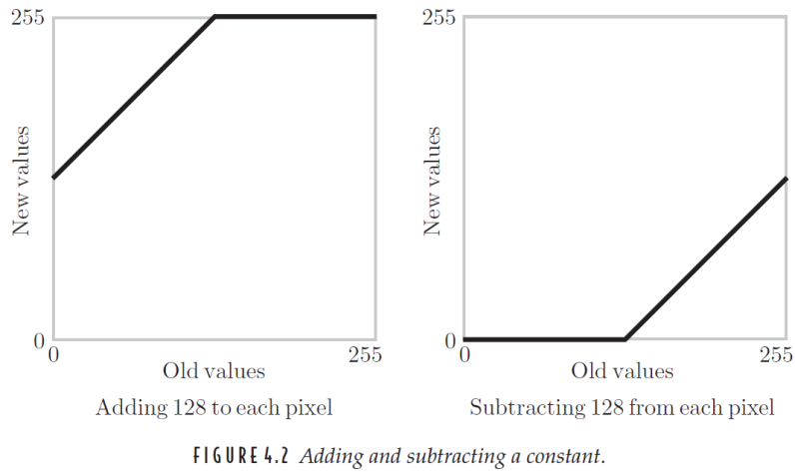
FIGURE 4.2
Ch4-p.67

Slide 7
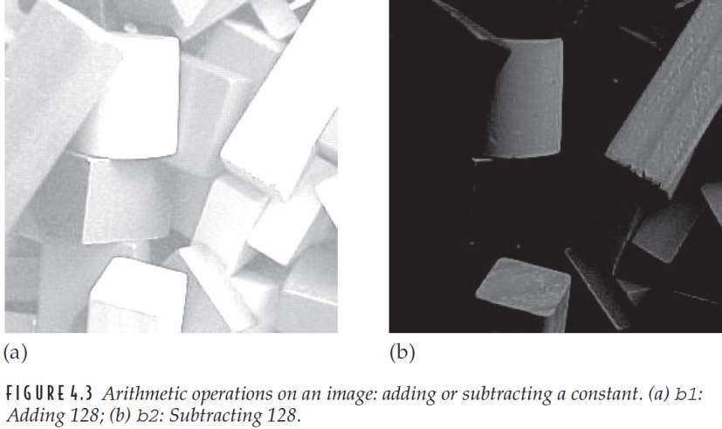
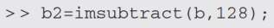
FIGURE 4.3
Ch4-p.68

Slide 8
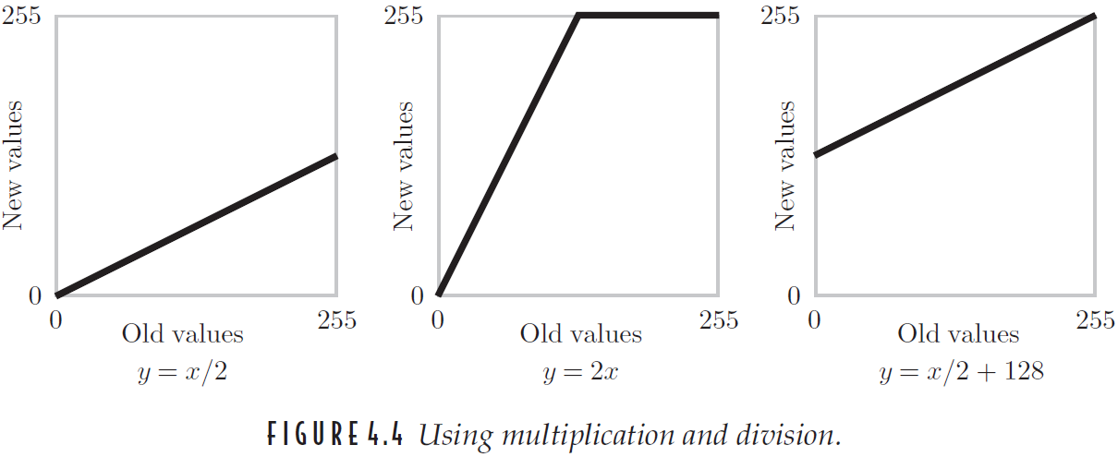
FIGURE 4.4
Ch4-p.68

Slide 9
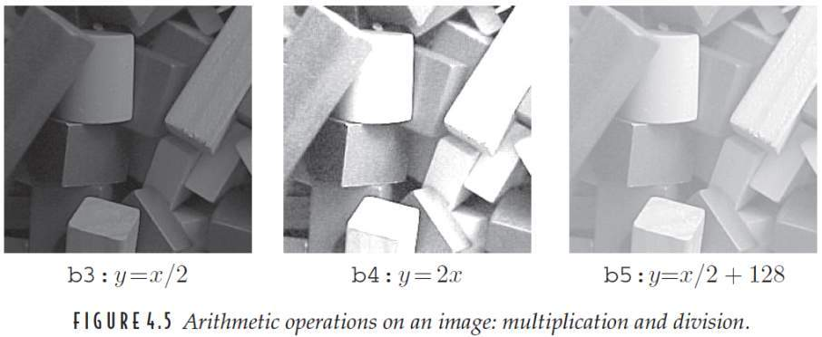
FIGURE 4.5
Ch4-p.69

Slide 10
exp07
請對一張影像做：
Image + 128
Image – 128
Image / 2
Image *2
Image / 2 + 128
以上請以function形式完成

Slide 11
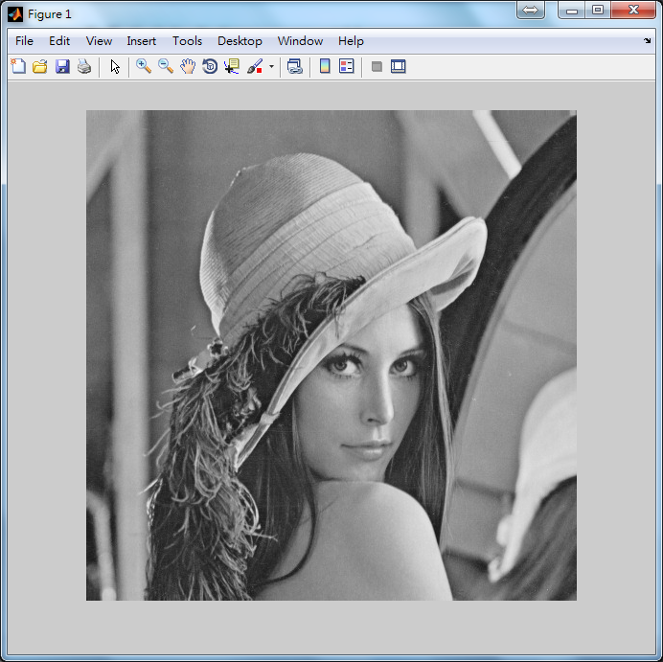
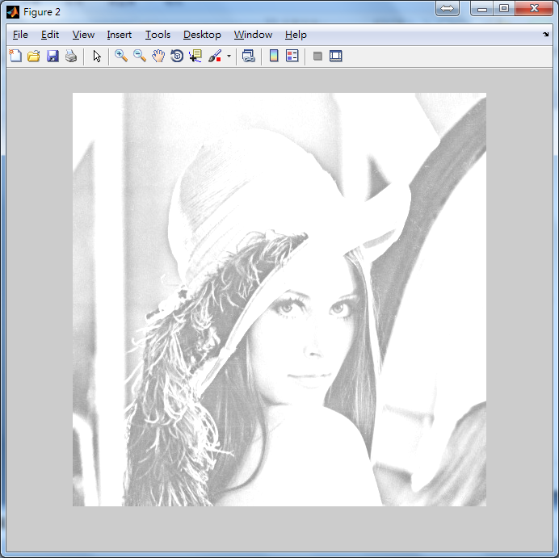
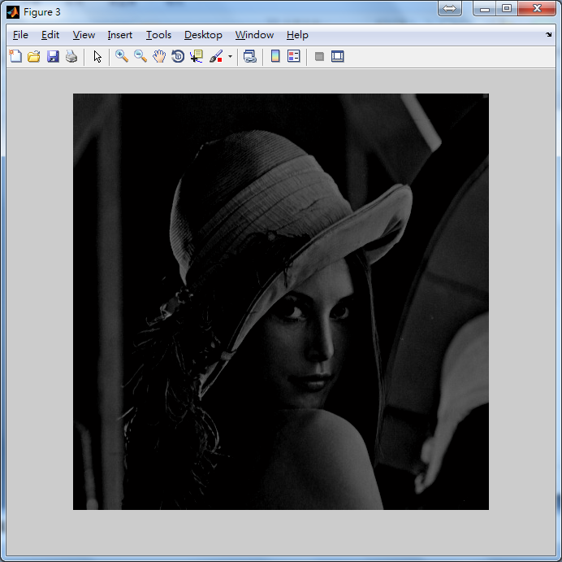
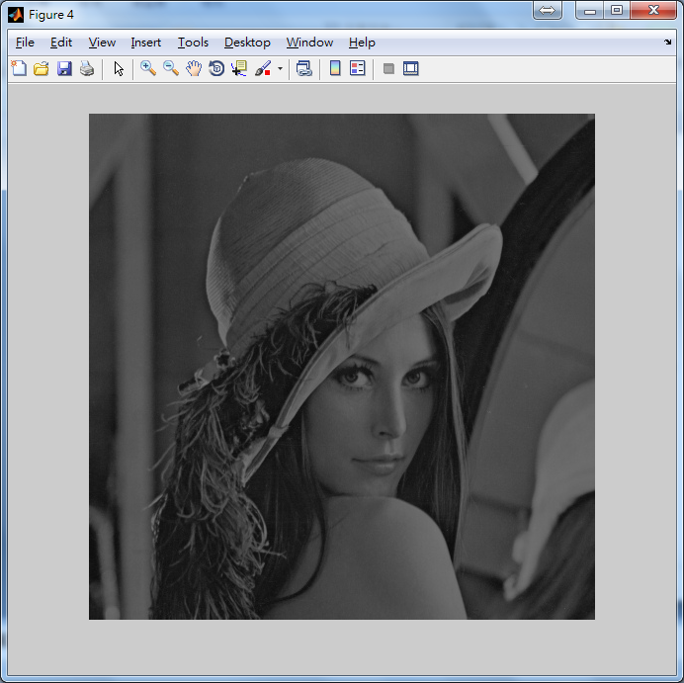
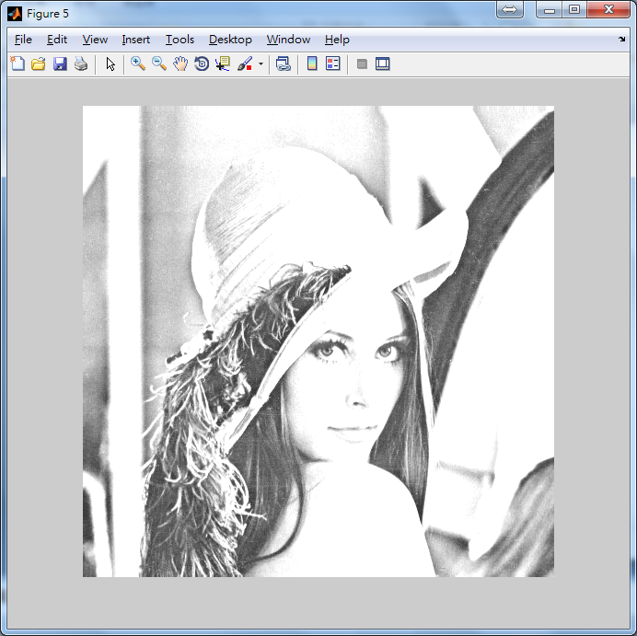
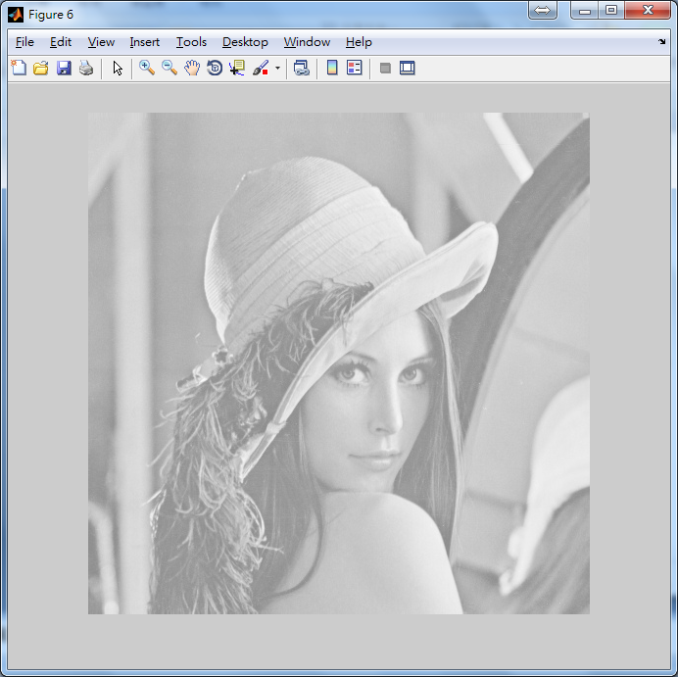

Slide 12
4.2 Arithmetic Operations
COMPLEMENTS
The complement of a grayscale image is its photographic negative
type double (0.0~1.0)
1-m
type uint8 (0~255)
255-m
Ch4-p.69

Slide 13
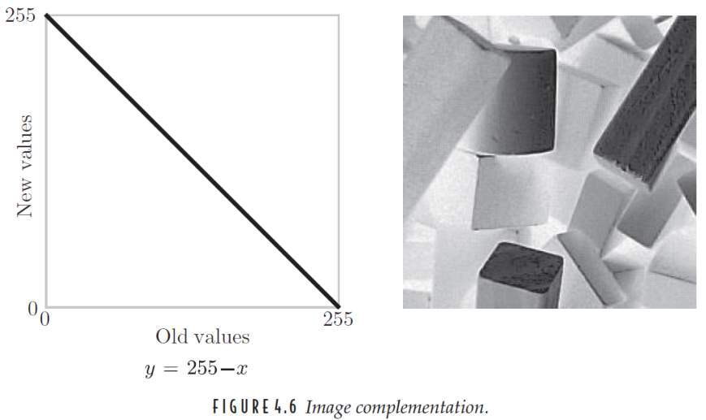
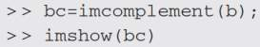
FIGURE 4.6
Ch4-p.70

Slide 14
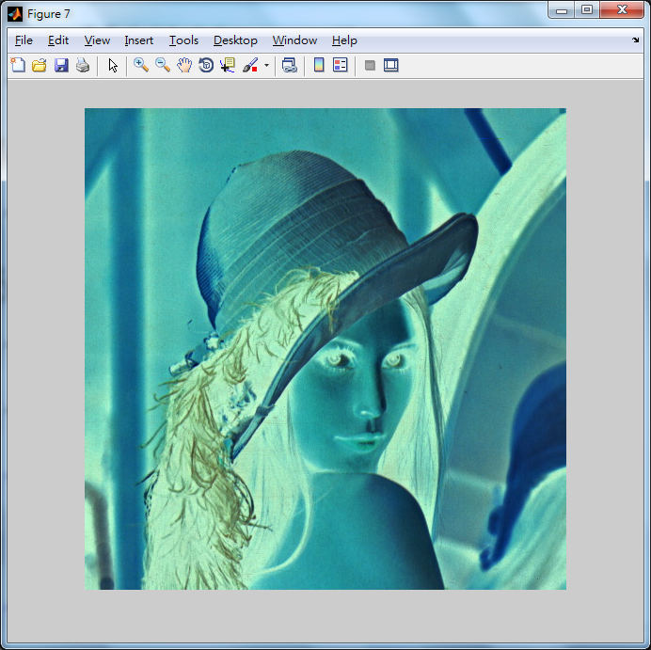
exp08
請對一張影像做：
255 - Image
以上請以function形式完成

Slide 15
4.3 Histograms
A graph indicating the number of times each gray level occurs in the image
a = [10 10 10 10 10;
20 20 20 20 10;
50 50 50 50 50;
90 90 90 50 50]
Ch4-p.71

Slide 16
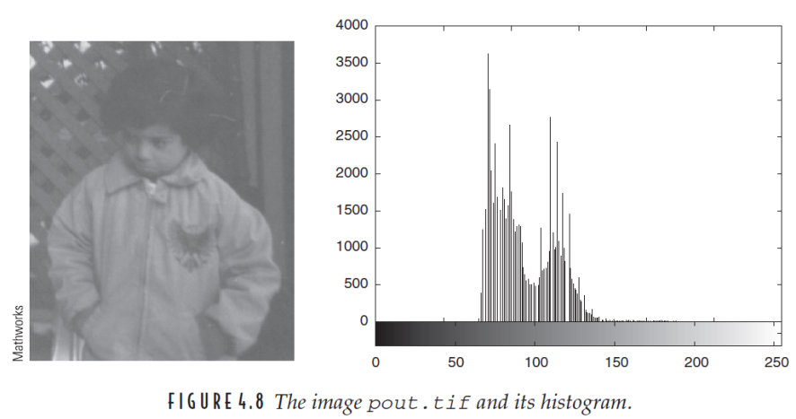
FIGURE 4.8
Ch4-p.71

Slide 17
4.3.1 Histogram Stretching
A table of the numbers n_{i} of gray values
(with n = 360, as before)
We can stretch out the gray levels in the center of the range by applying the piecewise linear function
Ch4-p.72

Slide 18
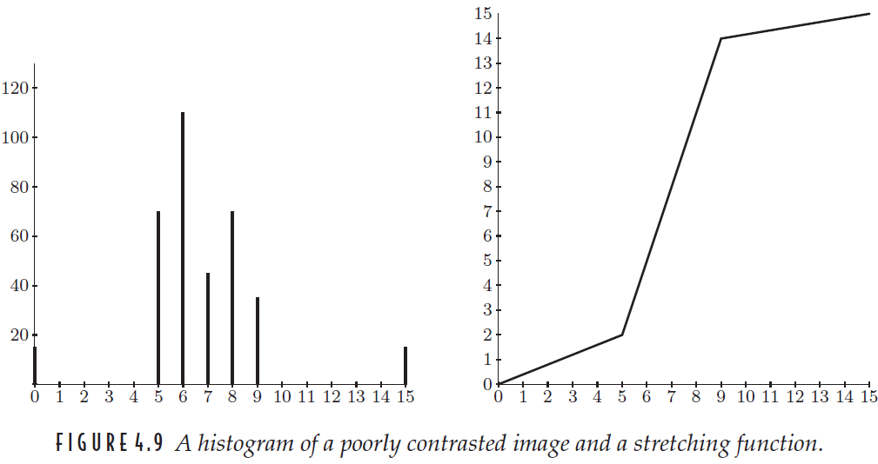
FIGURE 4.9
Ch4-p.72

Slide 19
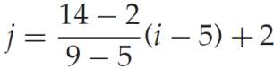
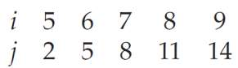
4.3.1 Histogram Stretching
where i is the original gray level and j is its result after the transformation
This function has the effect of stretching the gray levels 5–9 to gray levels 2–14
Ch4-p.72

Slide 20
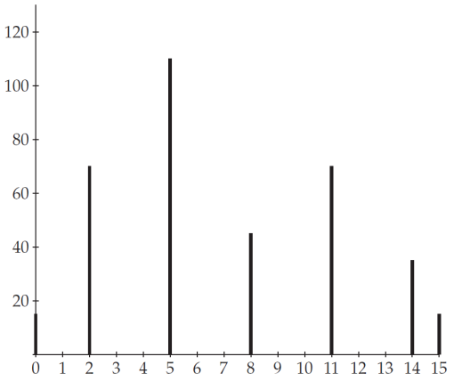
4.3.1 Histogram Stretching
the corresponding histogram
Ch4-p.73

Slide 21
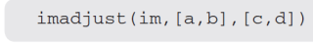
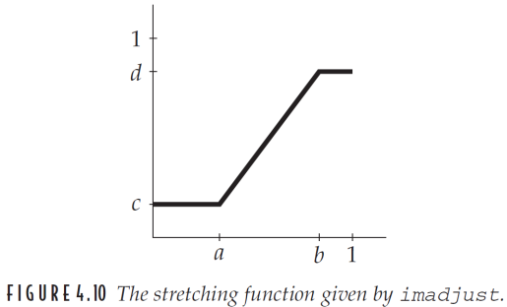
FIGURE 4.10
Use of imadjust
Ch4-p.73

Slide 22
4.3.1 Histogram Stretching
imadjust is designed to work equally well on images of type double, uint8, or uint16
the values of a, b, c, and d must be between 0 and 1
the function automatically converts the image im (if needed) to be of type double
Ch4-p.73

Slide 23
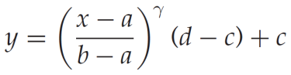
4.3.1 Histogram Stretching
Note that imadjust does not work quite in the same way as shown in Figure 4.9
The imadjust function has one other optional parameter: the gamma value
Ch4-p.73-74

Slide 24
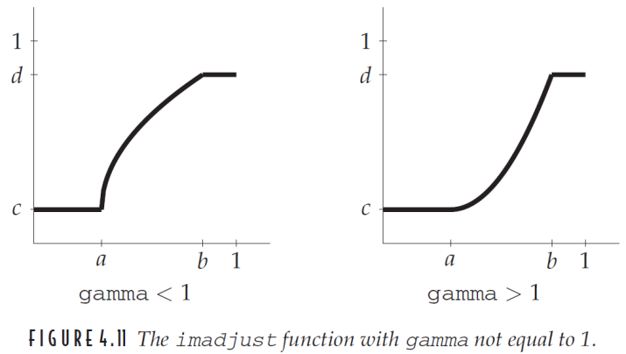
FIGURE 4.11
Ch4-p.74

Slide 25
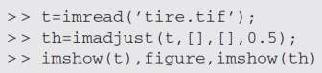
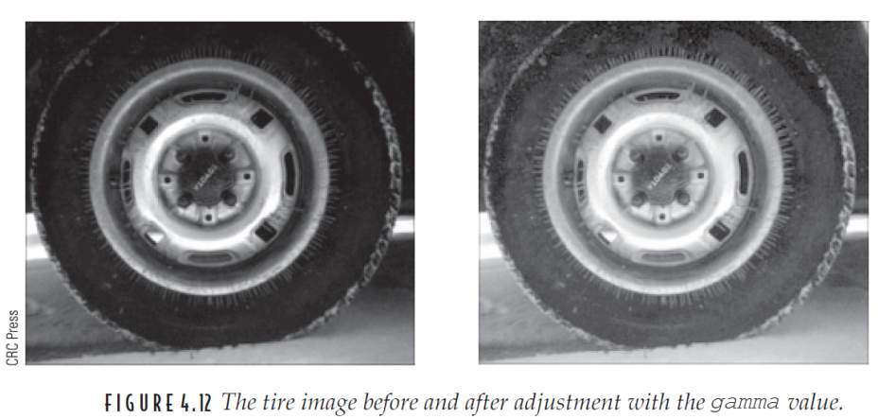
FIGURE 4.12
Ch4-p.75

Slide 26
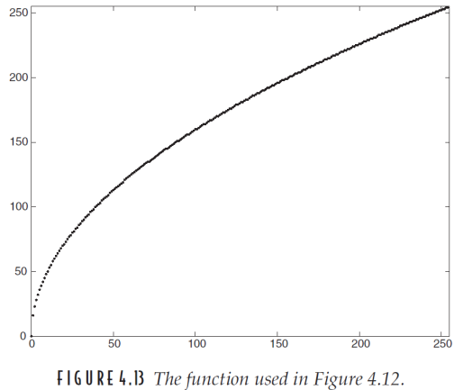
FIGURE 4.13
Ch4-p.76

Slide 27
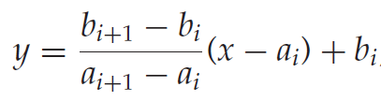
4.3.1 Histogram Stretching
A PIECE WISE LINEAR-STRETCHING FUNCTION
The heart of this function will be the lines
where im is the input image and out is the output image
Ch4-p.75-76

Slide 28
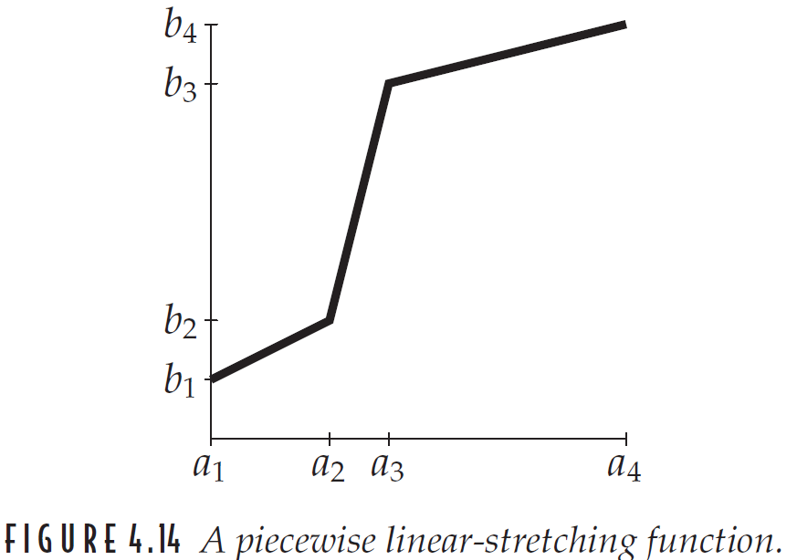
FIGURE 4.14
Ch4-p.76

Slide 29
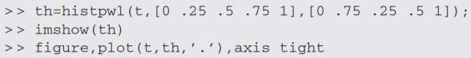
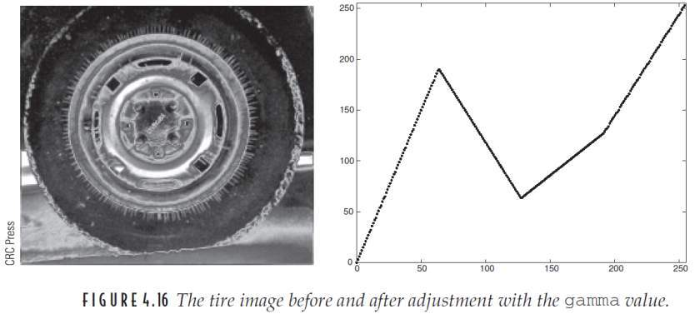
FIGURE 4.16
Refer to figure 4.15
The tire image after piecewise linear-stretching and piecewise linear-stretching function.
Ch4-p.78

Slide 30
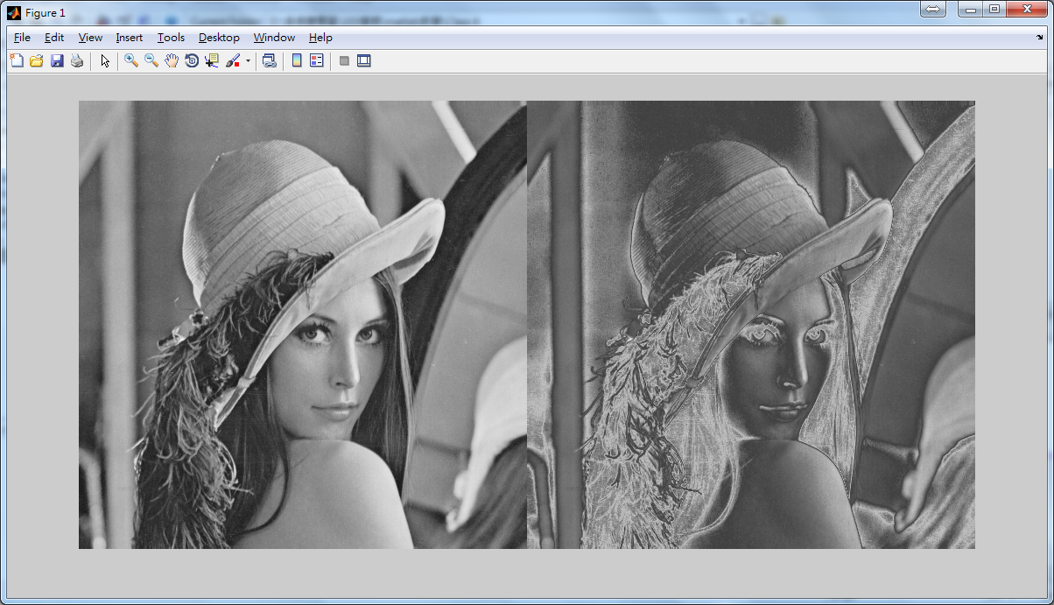
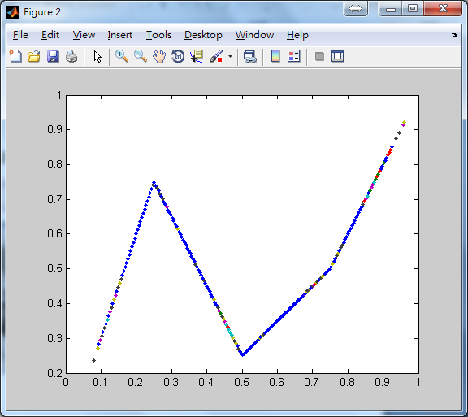
exp09
實作Figure 4.16

Slide 31
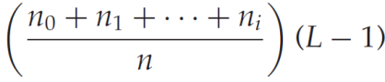
4.3.2 Histogram Equalization
An entirely automatic procedure
Suppose our image has L different gray levels, 0, 1, 2, . . . , L − 1, and gray level i occurs n_{i} times in the image
Where n=n₀ +n₁ +n₂ +· · ·+n_{L−1}
Ch4-p.78

Slide 32
4.3.2 Histogram Equalization
EXAMPLE Suppose a 4-bit grayscale image has the histogram shown in Figure 4.17, associated with a table of the numbers n_{i} of gray values
Ch4-p.78

Slide 33
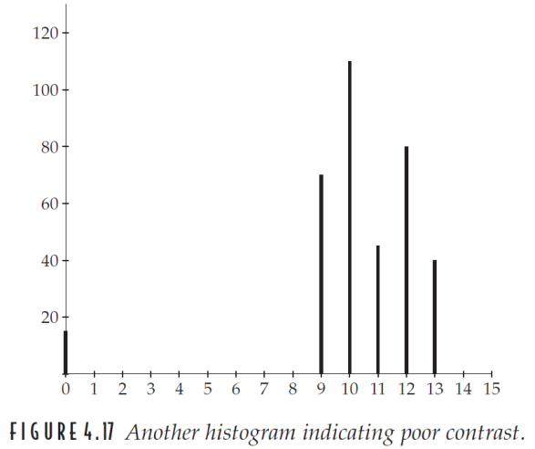
FIGURE 4.17
Ch4-p.79

Slide 34
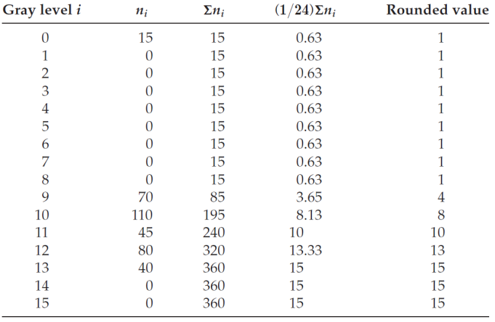
4.3.2 Histogram Equalization
(L-1)/n
Ch4-p.79

Slide 35
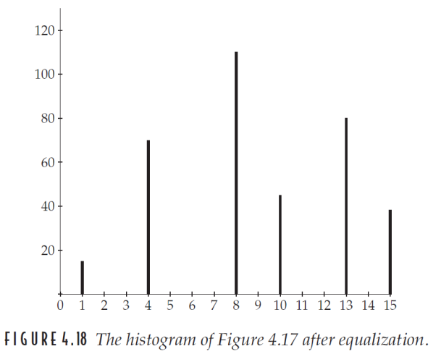
FIGURE 4.18
Ch4-p.80

Slide 36
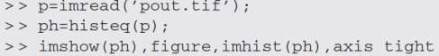
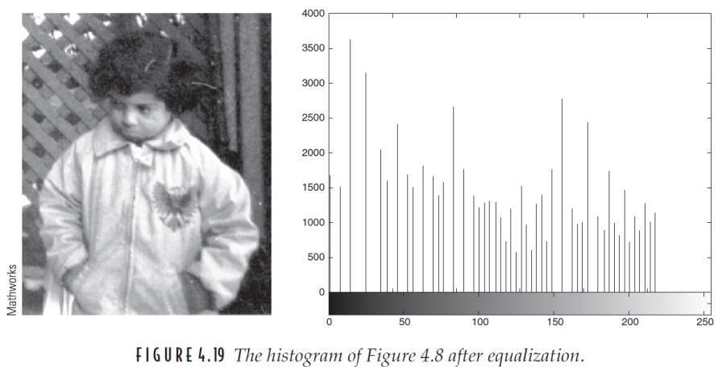
FIGURE 4.19
Ch4-p.80

Slide 37
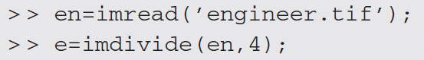
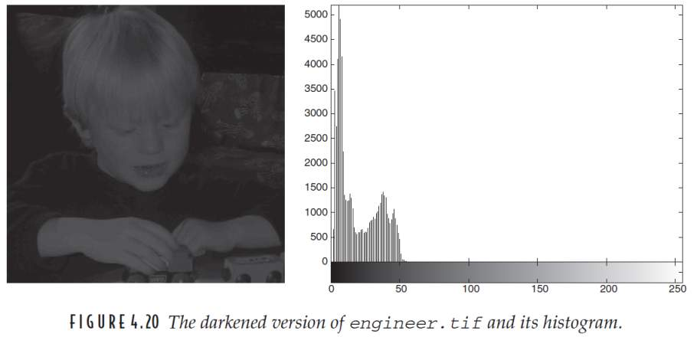
FIGURE 4.20
Ch4-p.81

Slide 38
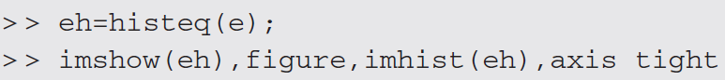
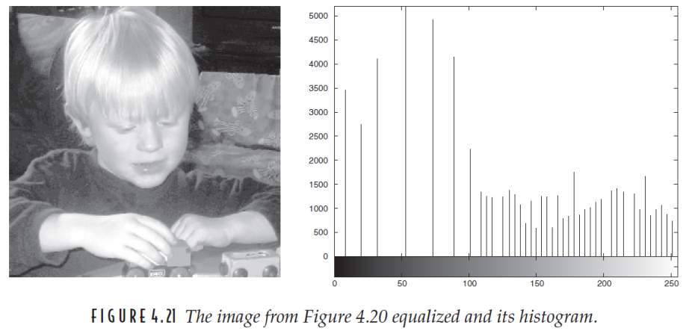
FIGURE 4.21
Ch4-p.82

Slide 39
4.3.2 Histogram Equalization
WHY IT WORKS If we were to treat the image as a continuous function f (x, y) and the histogram as the area between different contours, then we can treat the histogram as a probability density function.
Ch4-p.82-83

Slide 40
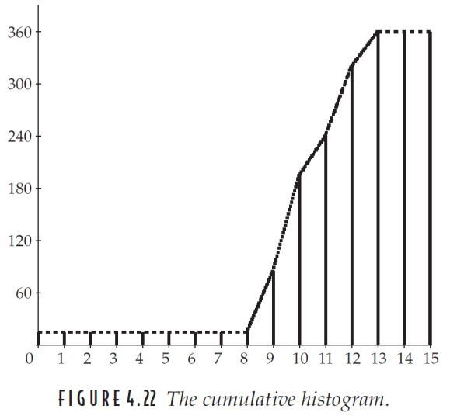
FIGURE 4.22
Ch4-p.82

Slide 41
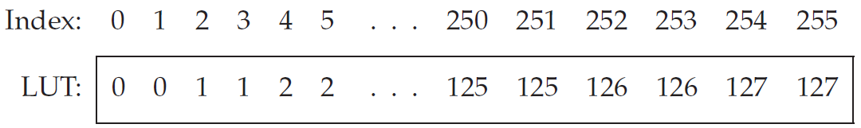
4.4 Lookup Tables
Point operations can be performed very effectively by using a lookup table, known more simply as an LUT
e.g., the LUT corresponding to division by 2 looks like
Ch4-p.83

Slide 42
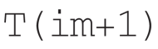
4.4 Lookup Tables
If T is a lookup table in MATLAB and im is our image, the lookup table can be applied by the simple command
e.g.,
>> b = b+1;
>> b2 = T(b+1);
Ch4-p.83

Slide 43
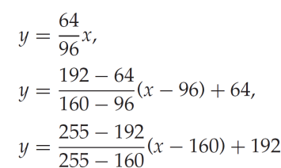
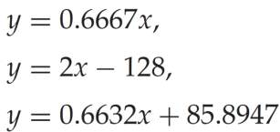
4.4 Lookup Tables
As another example, suppose we wish to apply an LUT to implement the contrast-stretching function
Ch4-p.83-84

Slide 44


FIGURE 4.23
Ch4-p.84

Slide 45

exp09
請使用histeq()對上禮拜的exp07結果處理。
以上請以function形式完成

Slide 47
histeq()

Slide 48







Slide 49

exp10
請實作Histogram Equalization
上禮拜的exp07結果，使用Histogram Equalization來處理
以上請以function形式完成

Slide 51
D_histeq()

Slide 52







